Slide 1
K medoids

Slide 2
K-MEDOIDS CLUSTERING
The mean in k-means clustering is sensitive to outliers.
Since an object with an extremely high value may substantially distort the distribution of data.
Hence we move to k-medoids.
K-Medoids (also called as Partitioning Around Medoid)
Instead of taking mean of cluster we take the most centrally located point in cluster as it’s center.
These are called medoids

Slide 3
K-MEDOIDS CLUSTERING
Pick actual objects to represent clusters instead of mean values
Each remaining object is clustered with the representative object (Medoid) to which is the most similar

Slide 4
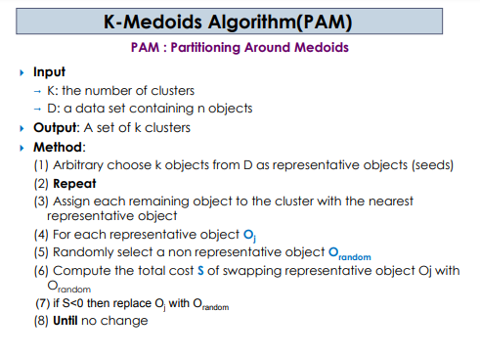

Slide 5
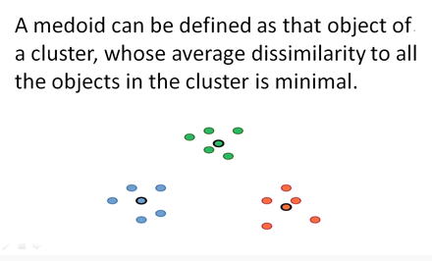

Slide 6
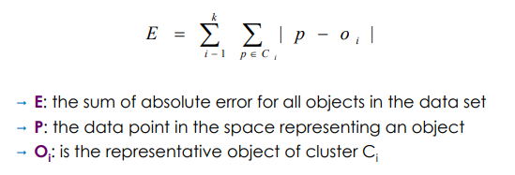
The cost in K-Medoids algorithm is given as

Slide 7
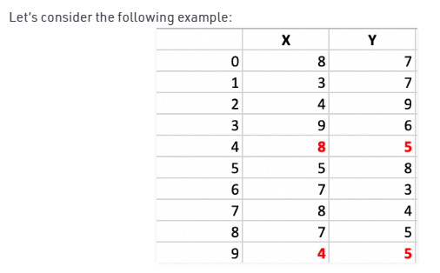
The dissimilarity of the medoid(Ci) and object(Pi) is calculated
by using E = |Pi - Ci|

Slide 8
Step 1:
Let the randomly selected 2 medoids, so select k = 2 and let
C1 (4, 5) and C2 (8, 5) are the two medoids.

Slide 9
Step 2: Calculating cost.
The dissimilarity of each non-medoid point with the medoids is calculated and tabulated:
Here Dissimilarity between two objects is measured using Manhattan distance

Slide 10
 | x | Y | Dissimilarity from C1(Cost) | Dissimilarity from C2(cost) | Cluster
0 | 8 | 7
1 | 3 | 7
2 | 4 | 9
3 | 9 | 6
4-C2 | 8 | 5 | - | -
5 | 5 | 8
6 | 7 | 3
7 | 8 | 4
8 | 7 | 5
9 –C1 | 4 | 5 | - | -

Slide 11
 | x | Y | Dissimilarity from C1(Cost) | Dissimilarity from C2(cost) | Cluster
0 | 8 | 7 | 6 | 2 | C2
1 | 3 | 7 | 3 | 7 | C1
2 | 4 | 9 | 4 | 8 | C1
3 | 9 | 6 | 6 | 2 | C2
4-C2 | 8 | 5 | - | -
5 | 5 | 8 | 4 | 6 | C1
6 | 7 | 3 | 5 | 3 | C2
7 | 8 | 4 | 5 | 1 | C2
8 | 7 | 5 | 3 | 1 | C2
9 –C1 | 4 | 5 | - | -
3+4+4
1+1+3+2+2
TOTAL COST=20

Slide 12
Each point is assigned to the cluster of that medoid whose dissimilarity is less.
The points 1, 2, 5 go to cluster C1 and 0, 3, 6, 7, 8
go to cluster C2.
The Cost = (3 + 4 + 4) + (3 + 1 + 1 + 2 + 2) = 20

Slide 13
Step 3:
randomly select one non-medoid point and recalculate the cost. Let the randomly selected point be (8, 4).
The dissimilarity of each non-medoid point with the medoids – C1 (4, 5) and C2 (8, 4) is calculated and tabulated.

Slide 14
 | x | Y | Dissimilarity from C1(Cost) | Dissimilarity from C2(cost) | Cluster
0 | 8 | 7 | 6 | 3 | C2
1 | 3 | 7 | 3 | 8 | C1
2 | 4 | 9 | 4 | 9 | C1
3 | 9 | 6 | 6 | 3 | C2
4 | 8 | 5 | 4 | 1 | C2
5 | 5 | 8 | 4 | 7 | C1
6 | 7 | 3 | 5 | 2 | C2
7-C2 | 8 | 4 | -
8 | 7 | 5 | 3 | 2 | C2
9 –C1 | 4 | 5
3+4+4
3+3+1+2+2
TOTAL COST=22

Slide 15
Each point is assigned to that cluster whose dissimilarity is less.
So, the points 1, 2, 5 go to cluster C1 and 0, 3,4, 6, 8 go to cluster C2.
The New cost = (3 + 4 + 4) + (2 + 2 + 1 + 3 + 3) = 22 Swap Cost = New Cost – Previous Cost = 22 – 20 and 2 >0
As the swap cost is not less than zero, we undo the swap becoz the previous choice was good
. This process repeats until there is no change

Slide 16
Advantages:
It is simple to understand and easy to implement.
K-Medoid Algorithm is fast and converges in a fixed number of steps.
PAM is less sensitive to outliers than other partitioning algorithms.

Slide 17
Disadvantages:
The main disadvantage of K-Medoid algorithms is that it is not suitable for clustering non-spherical (arbitrary shaped) groups of objects.
It may obtain different results for different runs on the same dataset because the first k medoids are chosen randomly.

